Slide 1

Evolving The Hybrid Cloud to Support Generative and Agentic Workloads
Alaa Youssef
Research Senior Manager, Cloud Native AI Platform
IBM T.J. Watson Research Center
asyousse@us.ibm.com
Feb 2025

Slide 2
Topics
IIDAI (IBM-UIUC) vision white paper
IBM’s AI Platform Architecture

Slide 3
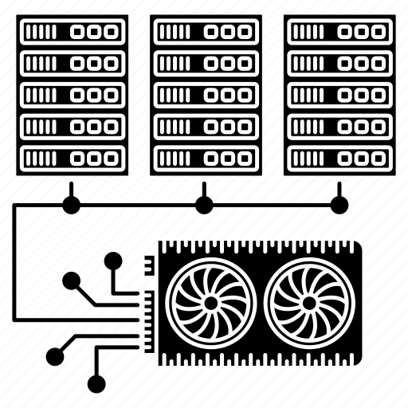


Optimizing the platform and infrastructure for foundation models …across the whole AI workflow
Data preparation
Distributed training
Model adaptation
Inference
Workflow of steps (e.g., remove hate and profanity, deduplicate, etc.)
Long-running job on massive infrastructure
Model tuning with custom data set for downstream tasks
May have sensitivity to latency, throughput, power,
Hours to days
weeks to months
minutes to hours
sub-second API request
10-2000+ low to mid-end CPU cores
10+ low to mid-end GPUs per
10-100+ concurrent jobs
10-1000+ high-end GPUs (per job)
10+ concurrent jobs
1+ mid to high-end GPU (per job)
100+ concurrent jobs
Fraction to multiple GPUs per inference, or specialized accelerator
Thousands of API requests
Agentic driven Multi-turn inference
on-prem
Public clouds
on-prem
Public clouds
on-prem
Public clouds
on-prem
Public clouds
Edge
Notes:
Pre-processing, debiasing, dedup

Slide 4
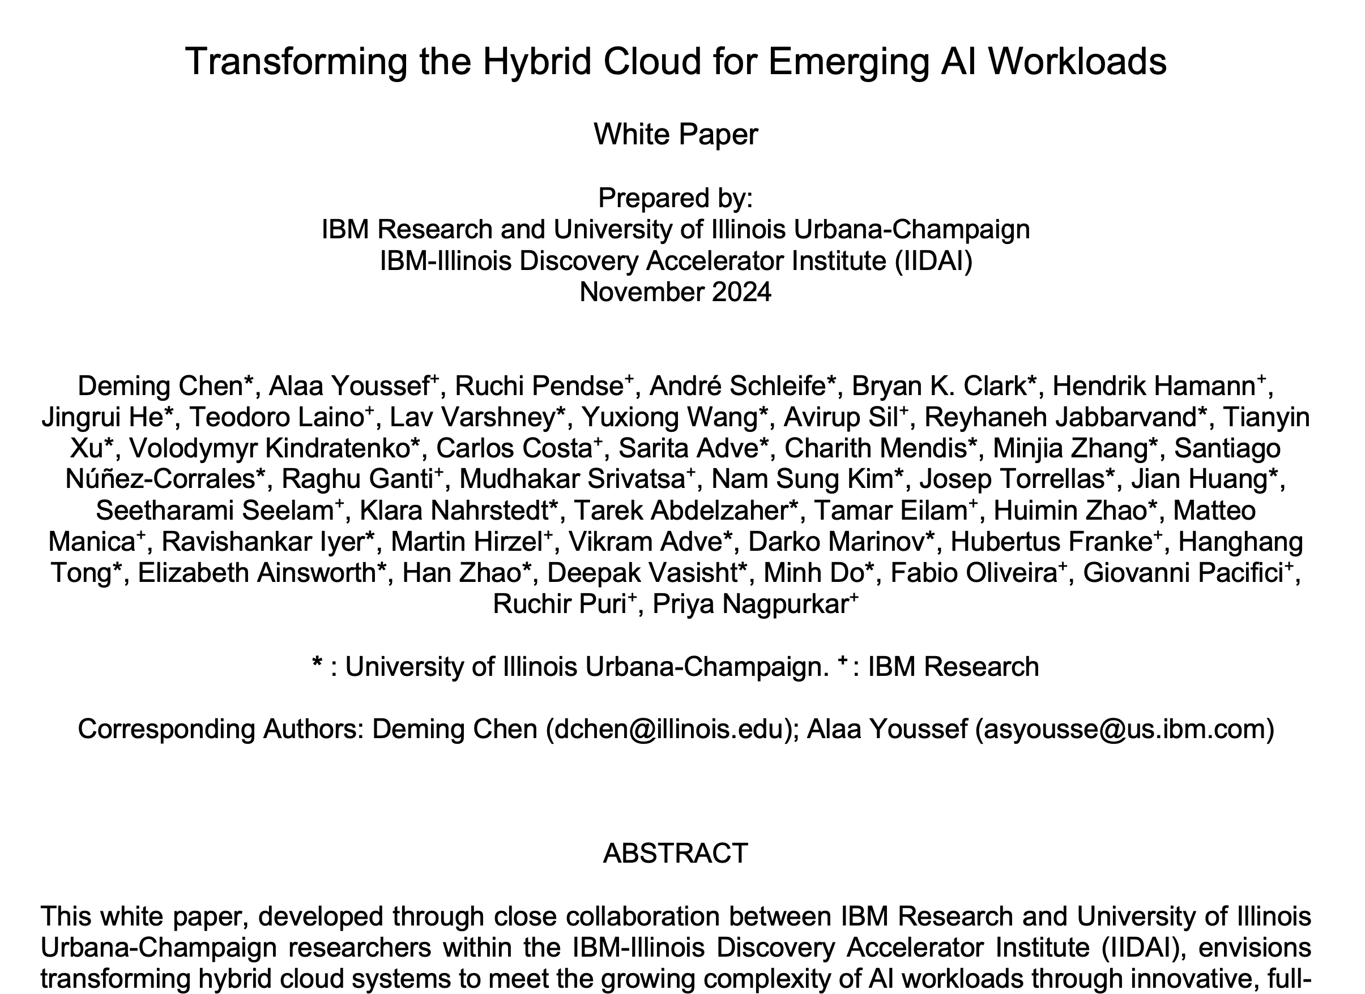
IIDAI Vision White Paper
https://arxiv.org/pdf/2411.13239

Slide 5
Goals
Identify new computing, storage, and communication elements, sub-systems, and innovations across all stack levels to transform the hybrid cloud for supporting emerging Gen-AI and Agentic workloads.
Attempt to answer the following two key questions:
(1) What is possible?
(2) What would be the outcome?
Reimagine the hybrid cloud featuring a fully integrated and optimized stack that supports a wide range of AI frameworks, runtimes, tools, and various hardware resources, including cache-coherent interconnects, SmartNiCs, AI accelerators, and quantum computers, etc.
Our aspiration is to achieve a 100-1000x improvement in performance/watt when all the pieces come together, over the next 5-10 years.
Focus is on ease of use, affordability, adaptability, and ubiquity at very large scales.
Our role is to spearhead and nurture the environment that will lead to the realization of these transformative technologies.

Slide 6
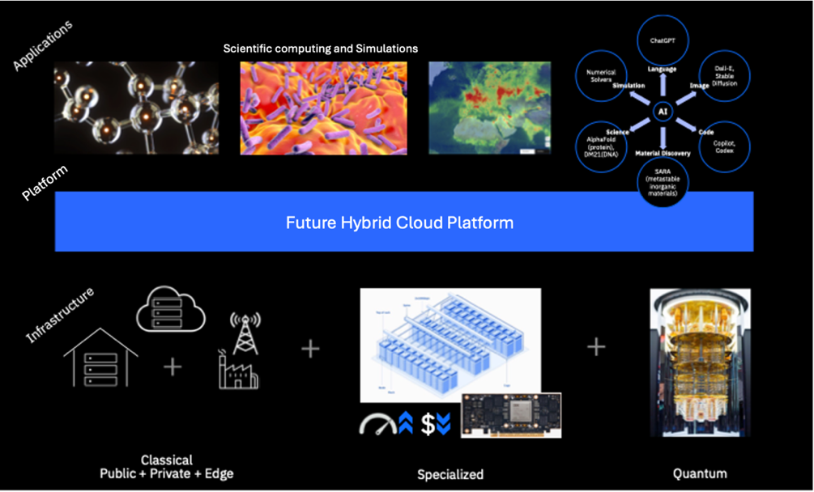
Hybrid Cloud of Today and Tomorrow
Today’s AI-infused Scientific Computing Applications, Platforms, and Infrastructures
AI-centric Hybrid Cloud Computing of the Future

Slide 7
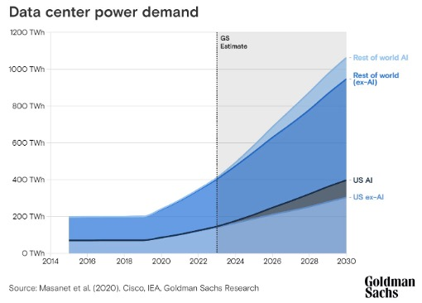
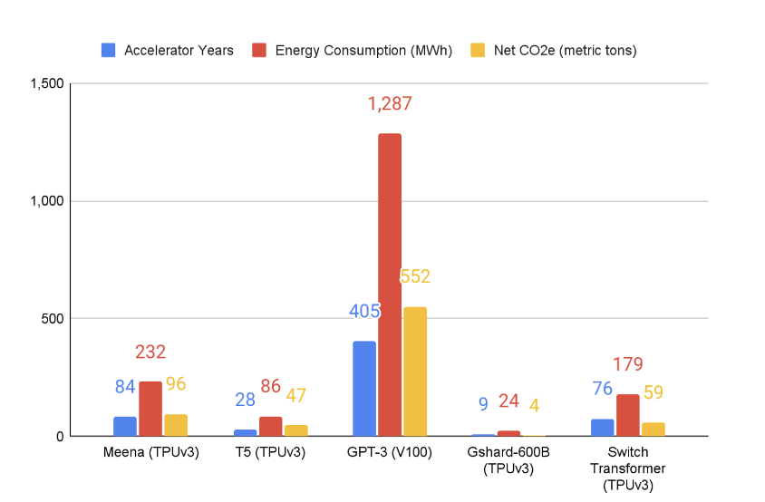
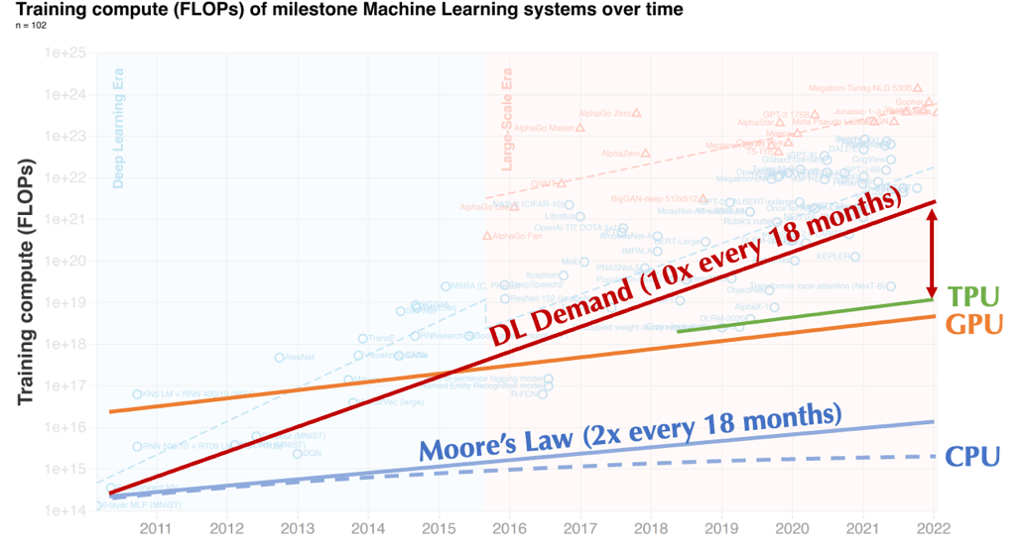
Challenges of AI-centric Hybrid Cloud Computing
Existing Hybrid Cloud Systems face the following key challenges:
Nonuniform interface/programming model/runtime, leading to difficult consumability
Growing large cloud systems, leading to engineering and management complexity
Inflexible system design, leading to poor adaptability
High compute and energy demands of large AI workloads, leading to limited affordability

Slide 8
Reinventing the Hybrid Cloud For The Future (Orange bars: new features; green boxes: enhanced components; blue boxes: existing components)
LLMaaA (LLM as an Abstraction)
Traditional
Abstractions
Agentic Frameworks
(LangGraph, DSPy, PDL, THINKagents)
Programming
Model
AI Compilers
and Runtimes
AI Frameworks (PyTorch, TensorFlow)
Accelerator Abstraction (Triton)
Ray/
CodeFlare
HPC Frameworks
(MPI, Charm++)
Workflow (Parsl, BrownDog)
Middleware/
Runtimes
Batch Processing
(Kueue, MCAD)
Serverless
(KNative)
Microservice
(ServiceWeaver)
Unified Control Plane
Multi-cloud Broker
Automation, Integration, Observability,
Efficiency, Optimization, Adaptability
Platform
Kubernetes/
OpenShift
LSF/
Slurm
Edge-Cloud Orchestrator
Bare Metal
VM/MicroVM
Containers
Infrastructure
Software-Defined Interface with Cache-Coherent Interconnect
Hardware
Host CPU
Memory
(w/ NDP)
Storage
(w/ NDP)
Networking
(w/ NDP)
Accelerators

Slide 9
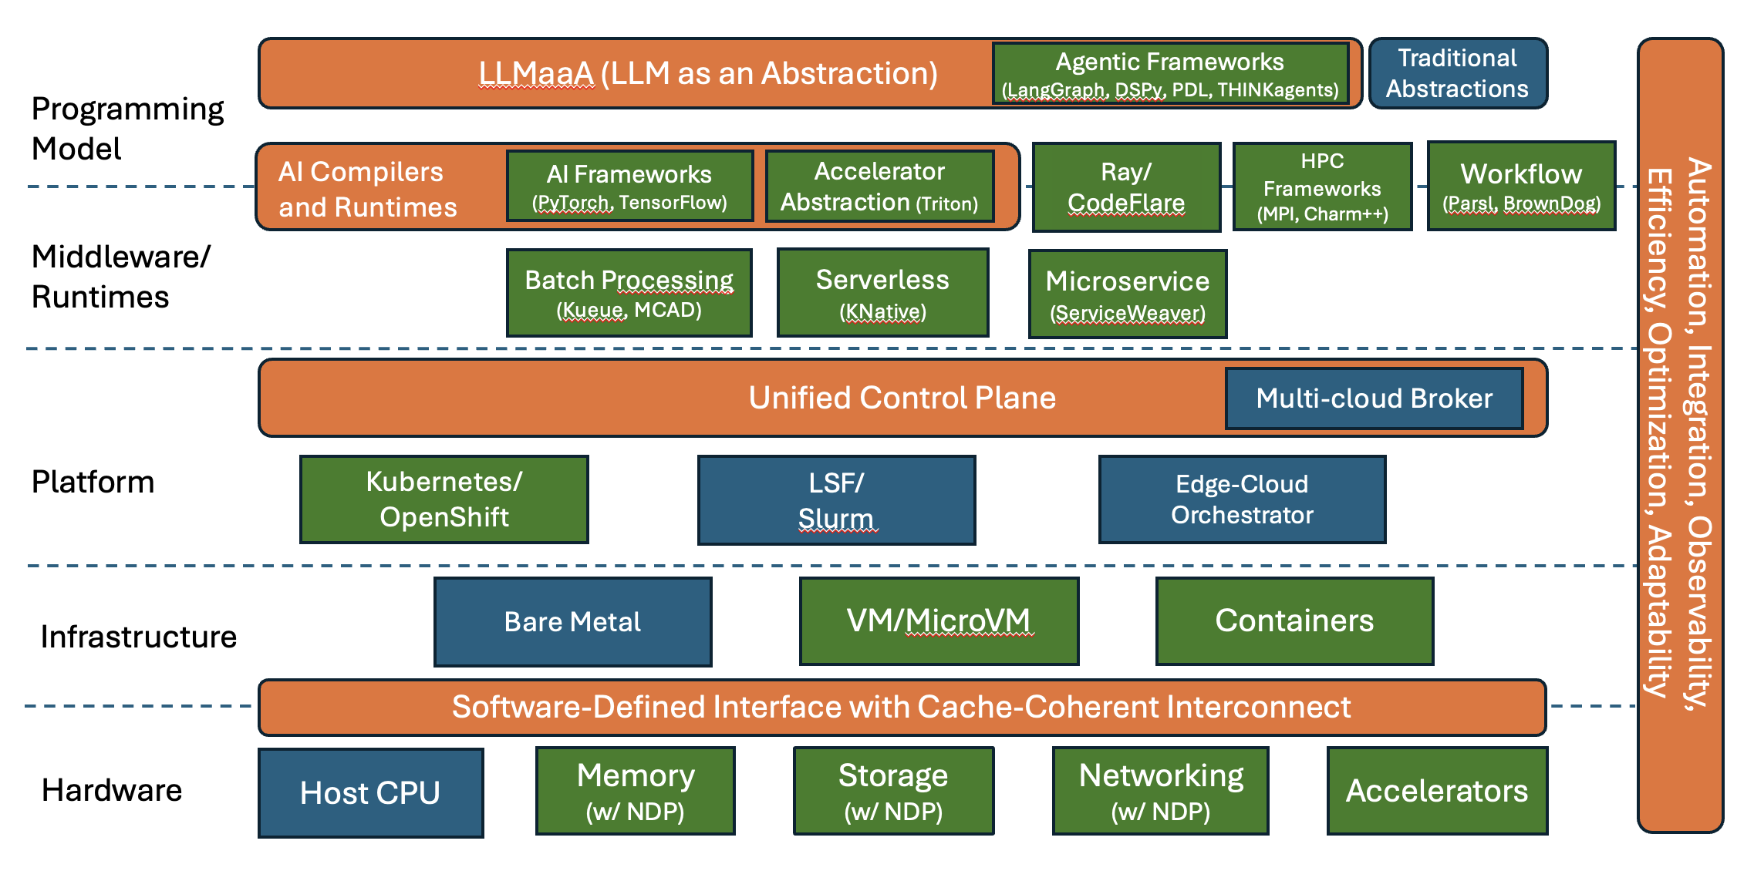
Reinventing the Hybrid Cloud For The Future (Orange bars: new features; green boxes: enhanced components; blue boxes: existing components)

Slide 10
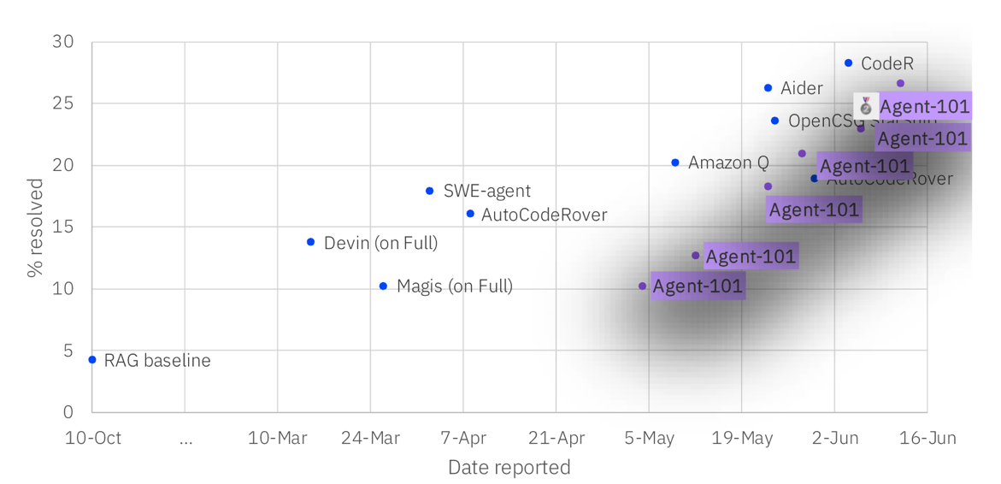
Agentic Systems
Advancing Collaboration and Intelligence in Agentic AI Systems
Improve how AI agents collaborate like human collective intelligence.
Achieve better task decomposition, chaining, and self-improvement, offering new research pathways in AI systems design, including systems-theoretic insights.
Overcome limitations of performing SWE and SRE tasks.

Slide 11
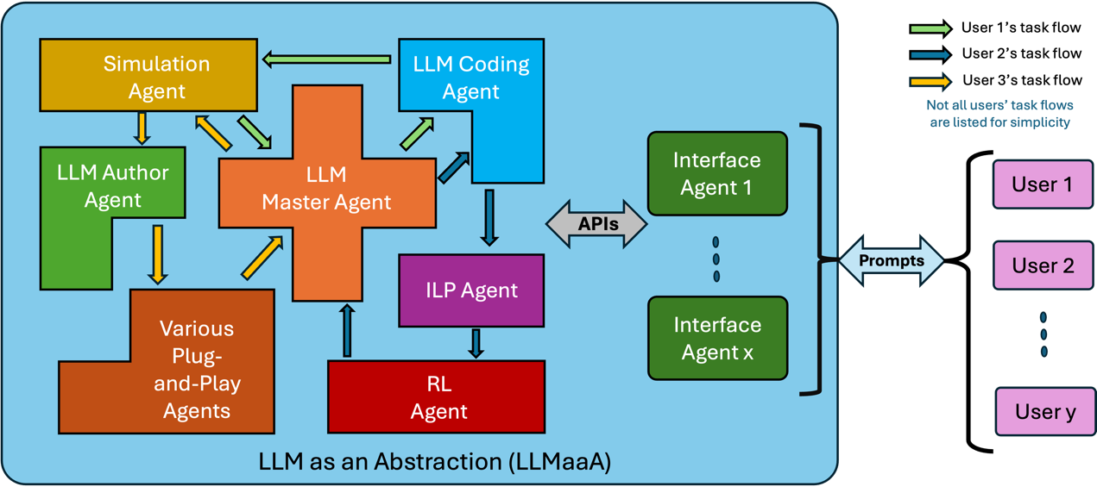
Agentic Systems
Advancing Collaboration and Intelligence in Agentic AI Systems
Improve how AI agents collaborate like human collective intelligence.
Achieve better task decomposition, chaining, and self-improvement, offering new research pathways in AI systems design, including systems-theoretic insights.
Overcome limitations of performing SWE and SRE tasks.
LLM-as-an-Abstraction (LLMaaA)
Novel paradigm for engaging with cloud computing and services, with a natural language interface.
Interface for building, deploying, and managing complex applications.
Driver for improving the adaptive programming model,
Driver for advancing secure, scalable cloud systems that flexibly integrate LLMs and specialized agents for evolving real-world applications.

Slide 12
AI Model Optimization & Runtimes
AI Compilers and Runtimes
Focus on AI compilers, framework-level optimizations, common accelerator abstractions and high-level kernels (e.g., OpenAI Triton), and leveraging hardware innovations to enable efficient scaling and optimization of emerging AI models.
Scaling FMs to handle larger context lengths is crucial for advancing AI applications in areas like NLP, climate prediction, and geospatial data.
Scaling sparse models which play a pivotal role in predictive analytics for fields like drug and material discovery, and quantum chemistry, but are challenging to scale due to irregular data.
Advance the IBM accelerator AIU Spyre software stack.
End-to-end Edge-Cloud Transformation and Optimization
Optimize the balance between edge and cloud AI computation based on flexible SLOs, leveraging fine grained composable acceleration.
Focus on unified programming models, specialized data communication methods, co-design of neural architectures and accelerators, and integrated offline and online optimization techniques.
End-to-end system prototypes and benchmarking are essential to validate these ideas.

Slide 13
HC Platform & Middleware
Adaptive Middleware and Runtime in Hybrid Cloud Systems
Design a unified control plane for AI-powered management of the resources in heterogeneous and dynamic cloud environments.
The goal is to make future hybrid cloud dynamically adjust to real-time workload demands, evolving system topologies, and edge-cloud coordination, through AI-driven workload management.
Advanced collective communication primitives, leveraging emerging technologies like UCIe, CXL, UALink, UltraEthernet, etc., in designing a uniform communication interface that addresses multiple granularity levels spanning from chiplets to intra-node and inter-node communication patterns.
Cross-Layer Automation and Integration
Optimize cloud infrastructure for complex computations, cross-layer automation, integration, and observability.
Efficient resource allocation, scheduling, and SLO optimization, ensuring minimal delays and max availability.
Develop automated frameworks for seamless orchestration and monitoring across cloud layers, which will improve efficiency, flexibility, robustness, adaptivity, and scalability.
Robustness and System Health Monitoring for AI in Hybrid Cloud: Advanced fault detection, and self-healing algorithms and mechanisms to ensure long-term health, resiliency, and dependability.
Energy-Efficient AI Workloads and Sustainability in Hybrid Cloud Systems
Enable AI runtimes to make energy-aware decisions during model training and inferencing, contributing to carbon efficiency while maintaining high performance.
Develop AI-driven energy management techniques that dynamically optimize energy consumption across hybrid multi-cloud systems powered by diversified energy sources, including renewable sources.
Adaptive techniques to balance energy and performance via smart workload distribution between edge devices and cloud resources.

Slide 14
Infrastructure & Security
Unified, Programmable, and AI-Optimized Networking for Distributed AI Workloads
Design unified, reconfigurable, and AI-optimized software defined networking that facilitates secure and efficient data transfer across a shared hybrid cloud environments, eliminating inefficiencies and security vulnerabilities in inter- and intra-node communications.
AI-driven network orchestration schemes that intelligently allocate bandwidth and resources, minimizing latency and cost while maximizing throughput for AI frameworks, like PyTorch, and ensuring secure data flow across diverse networking protocols (e.g., RoCE v2, InfiniBand).
Advancing AI Systems through Co-Design and Emerging Hardware Innovations
Streamline data transfers and optimize memory access leveraging system co-design and emerging hardware technologies such as Compute Express Link (CXL), Advanced Matrix Extensions (AMX), and GPUDirect.
Software-defined interfaces and cache-coherent interconnects need to be co-designed to improve fine-grained computational efficiency and system security and isolation across AI workloads.
Data Management and Storage Efficiency for Large Models
Place and migrate data in real-time, ensuring efficient storage use while reducing bottlenecks – not just within a single cloud, but also across edge devices, private clouds, and public clouds.
Innovate distributed data caching and management schemes that intelligently distribute and manage large amounts of data (e.g., KV-Cache) across AI-Accelerator/CPU memory, SSDs, and node-local storage in hybrid cloud environments securely and efficiently.
Adaptive and Reconfigurable Cloud Infrastructures for AI Workloads
Enhance reconfigurability and adaptability in hybrid cloud system through technologies such as programmable SmartNiCs and in-network switches, reconfigurable hardware and interconnects, software-defined programmable interface, and workload-adaptive control strategies.
Coordinated reconfiguration and specialization tailored towards specific workload characteristics will enable clouds to achieve significant performance gains, making them more affordable.

Slide 15
Applications Powered by Our Vision

Slide 16
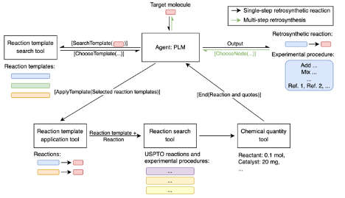
Materials Discovery
Challenges
Long-term Vision
Availability of high-quality and diverse datasets, which are necessary to train these FMs effectively.
Models that can generalize across many types of data.
Complexity of material representations. FMs need to handle various types of material data, e.g., molecular graphs and multimodal data from different domains.
A unified, overarching framework capable of handling a wide array of material tasks, from property prediction to material generation.
Development of FMs that can be trained on vast, multimodal datasets that include chemical and physical properties, structural information, spectroscopic data, and simulations from various domains.
Unlock a more holistic understanding of materials through sophisticated fusion methods, ranging from early fusion, where multi-modal data is combined at the input level, to late fusion, where results from individual modalities are merged at the decision-making stage.
FMs are expected to play a pivotal role in inverse design – novel materials that meet predefined properties.
Developing intelligent agents capable of leveraging specialized computational tools and environments.
Overview of foundation model for generating faithful retrosynthetic pathways and experimental procedures.

Slide 17
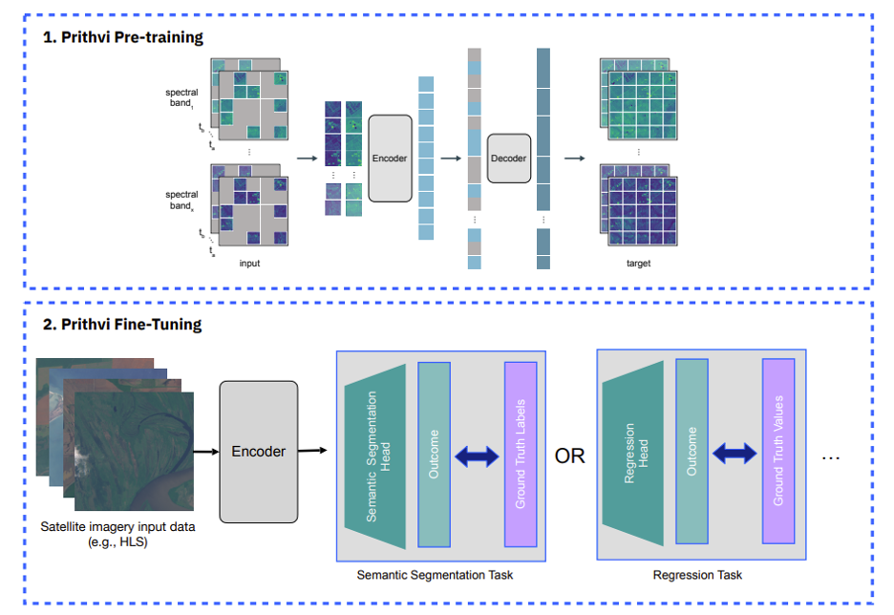
Climate and Sustainability
Challenges
Long-term Vision
Multi-modal geospatial models (vector, raster, text etc.), dealing with big number of modalities and channels.
Novel architectures to address pre-training across multi-dimensional data.
Disparity in resolution, of different data modalities, presents difficulties in integrating multi-modal data.
Composability of geospatial FMs, e.g., weather and satellite imagery FMs.
Scalable and efficient architectures and approaches for developing FMs, which can deal with the multi-modal and high dimensional data, with disparity in resolution.
Applications of fine-tuned FMs in climate impact (physical, economic, etc.), climate mitigation (carbon sequestration, etc.), and greenhouse gas emission quantification.
Climate and sustainability solutions enabled through Quantum Computing.
Prithvi geospatial model training and tuning, IBM-NASA collaboration

Slide 18
The Role of Quantum Computing

Slide 19
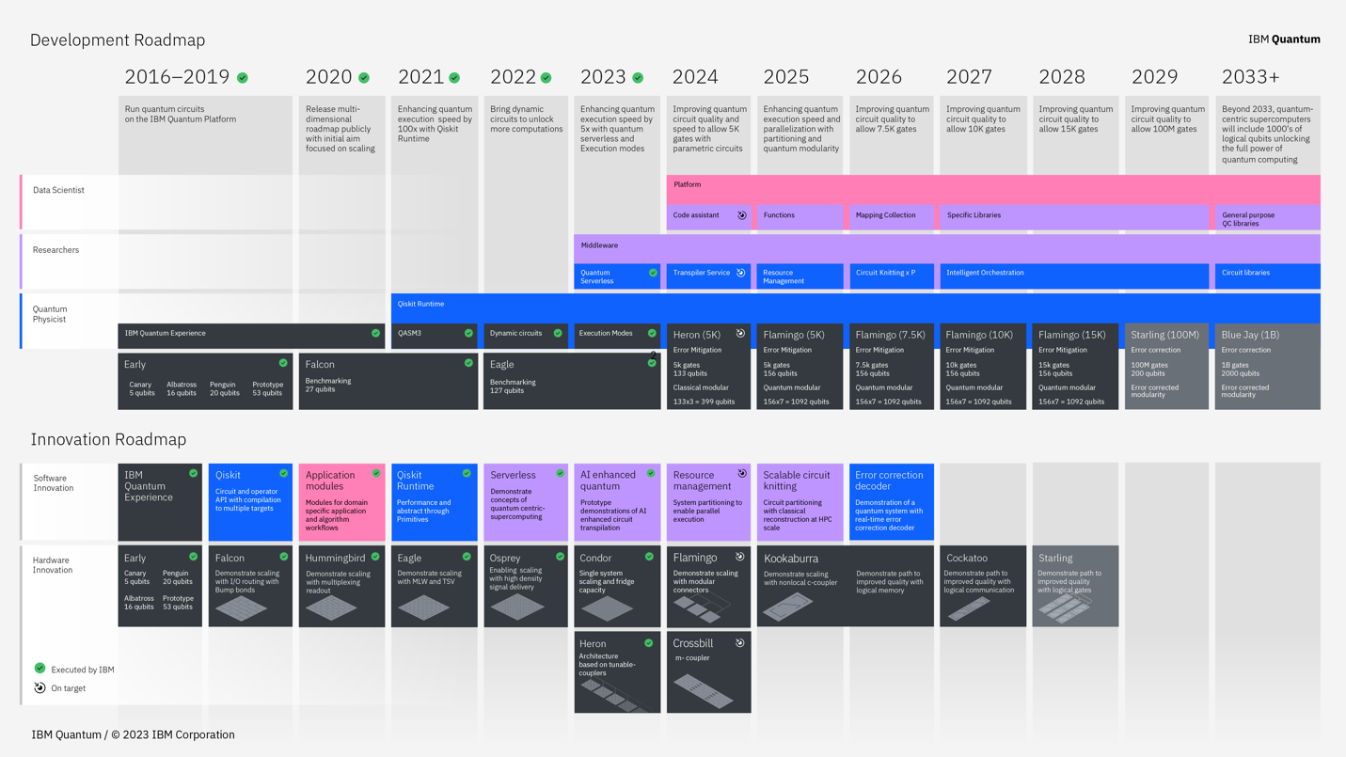
The Role of Quantum Computing
Challenges
Long-term Vision
Showing the benefit of quantum utility scale across many domains.
Pushing the envelope for error correction as well as error mitigation to reduce noise.
Become an organic part of the hybrid cloud system.
Expand the realm of application problems that benefit from quantum utility scale systems.
Start with applications in quantum chemistry, materials science, and physics, but eventually, the impact must be broader across computational fields.
Implementation of quantum computing aspects into existing computational workflows, replacing classical algorithms.
Training of a qualified quantum workforce, starting at the high-school level, but focusing on undergrad and grad levels, as well as postdocs.
Develop quantum literacy in computational domain scientists, to enable future development of computational software packages with quantum integration.

Slide 20
IBM’s AI Platform Architecture

Slide 21
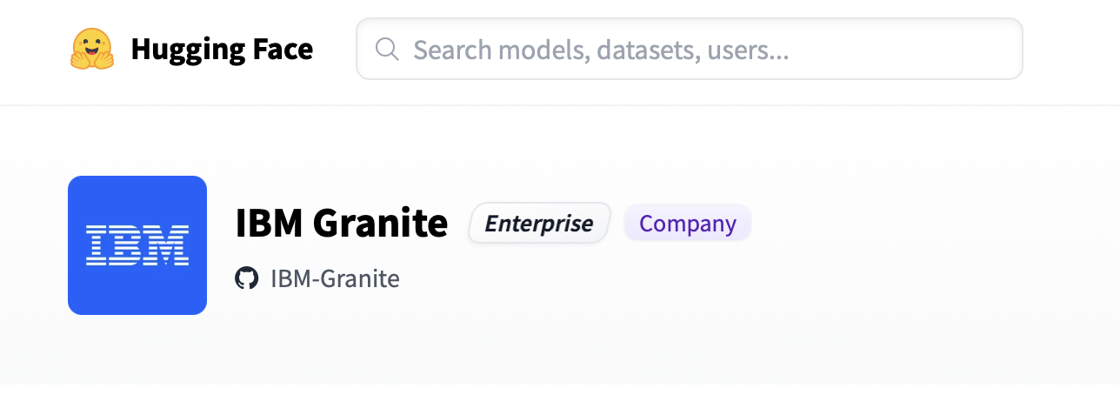
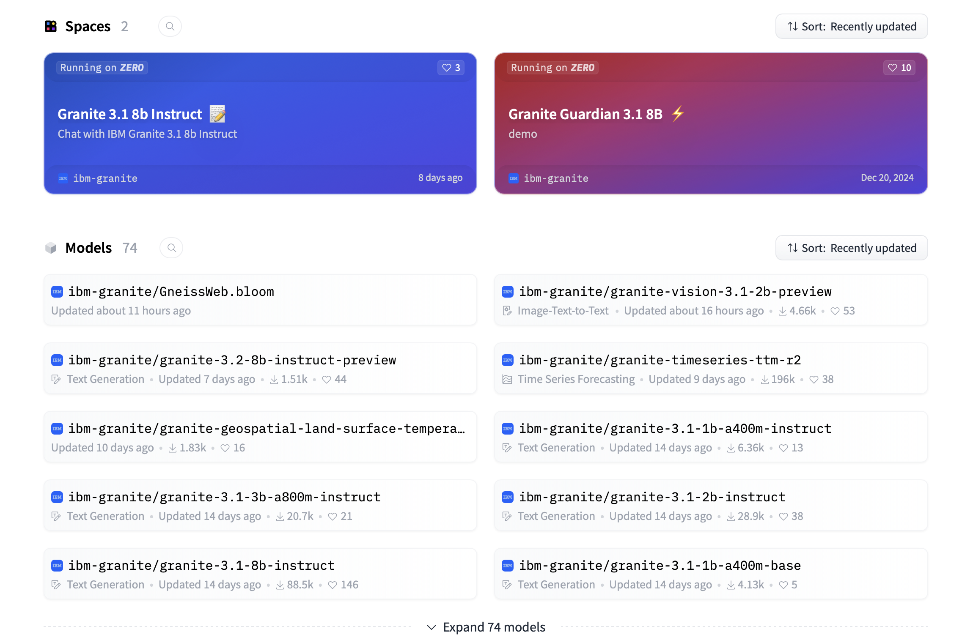

Slide 22
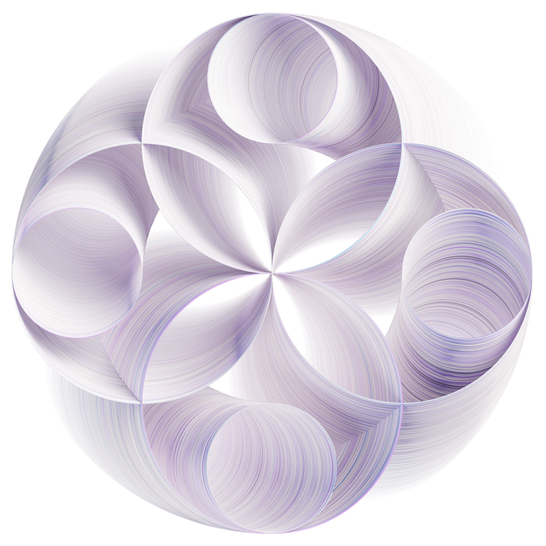
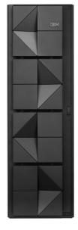
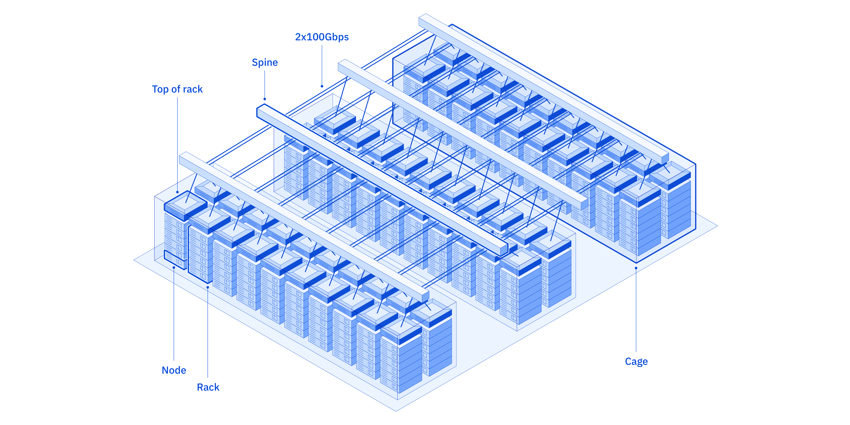
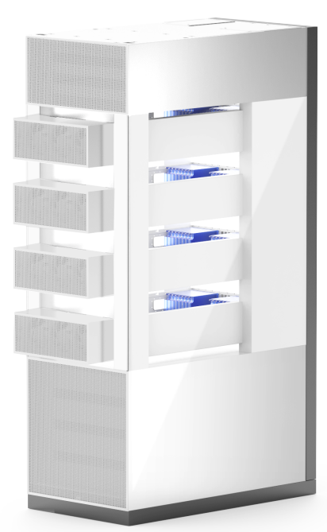
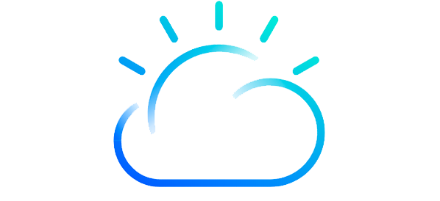
IBM’s Full-stack Approach to Generative AI
AI products and solutions | WCA (watsonx code assistant) | Watson assistant, Orchestrate (Digital labor) | …
Software and SaaS partners
AI and data platform | watsonx watsonx.ai watsonx.data watsonx.governance
Enterprise-ready
Performant and efficient, purpose-built models, guardrails and integrations
Consulting Services
Open
Building on and extending our open, cloud-native approach to AI frameworks, middleware and models
Hybrid cloud platform | Red Hat OpenShift AI OpenShift RHEL AI Enterprise Linux
Hybrid cloud Infrastructure and Hardware | Available in the Cloud or on-prem
IBM Z
IBM Vela
IBM Research AIU-based Prototypes
Hybrid
Consistency and flexibility across cloud and on-prem environments; support for heterogeneous accelerators
IBM Cloud

Slide 23

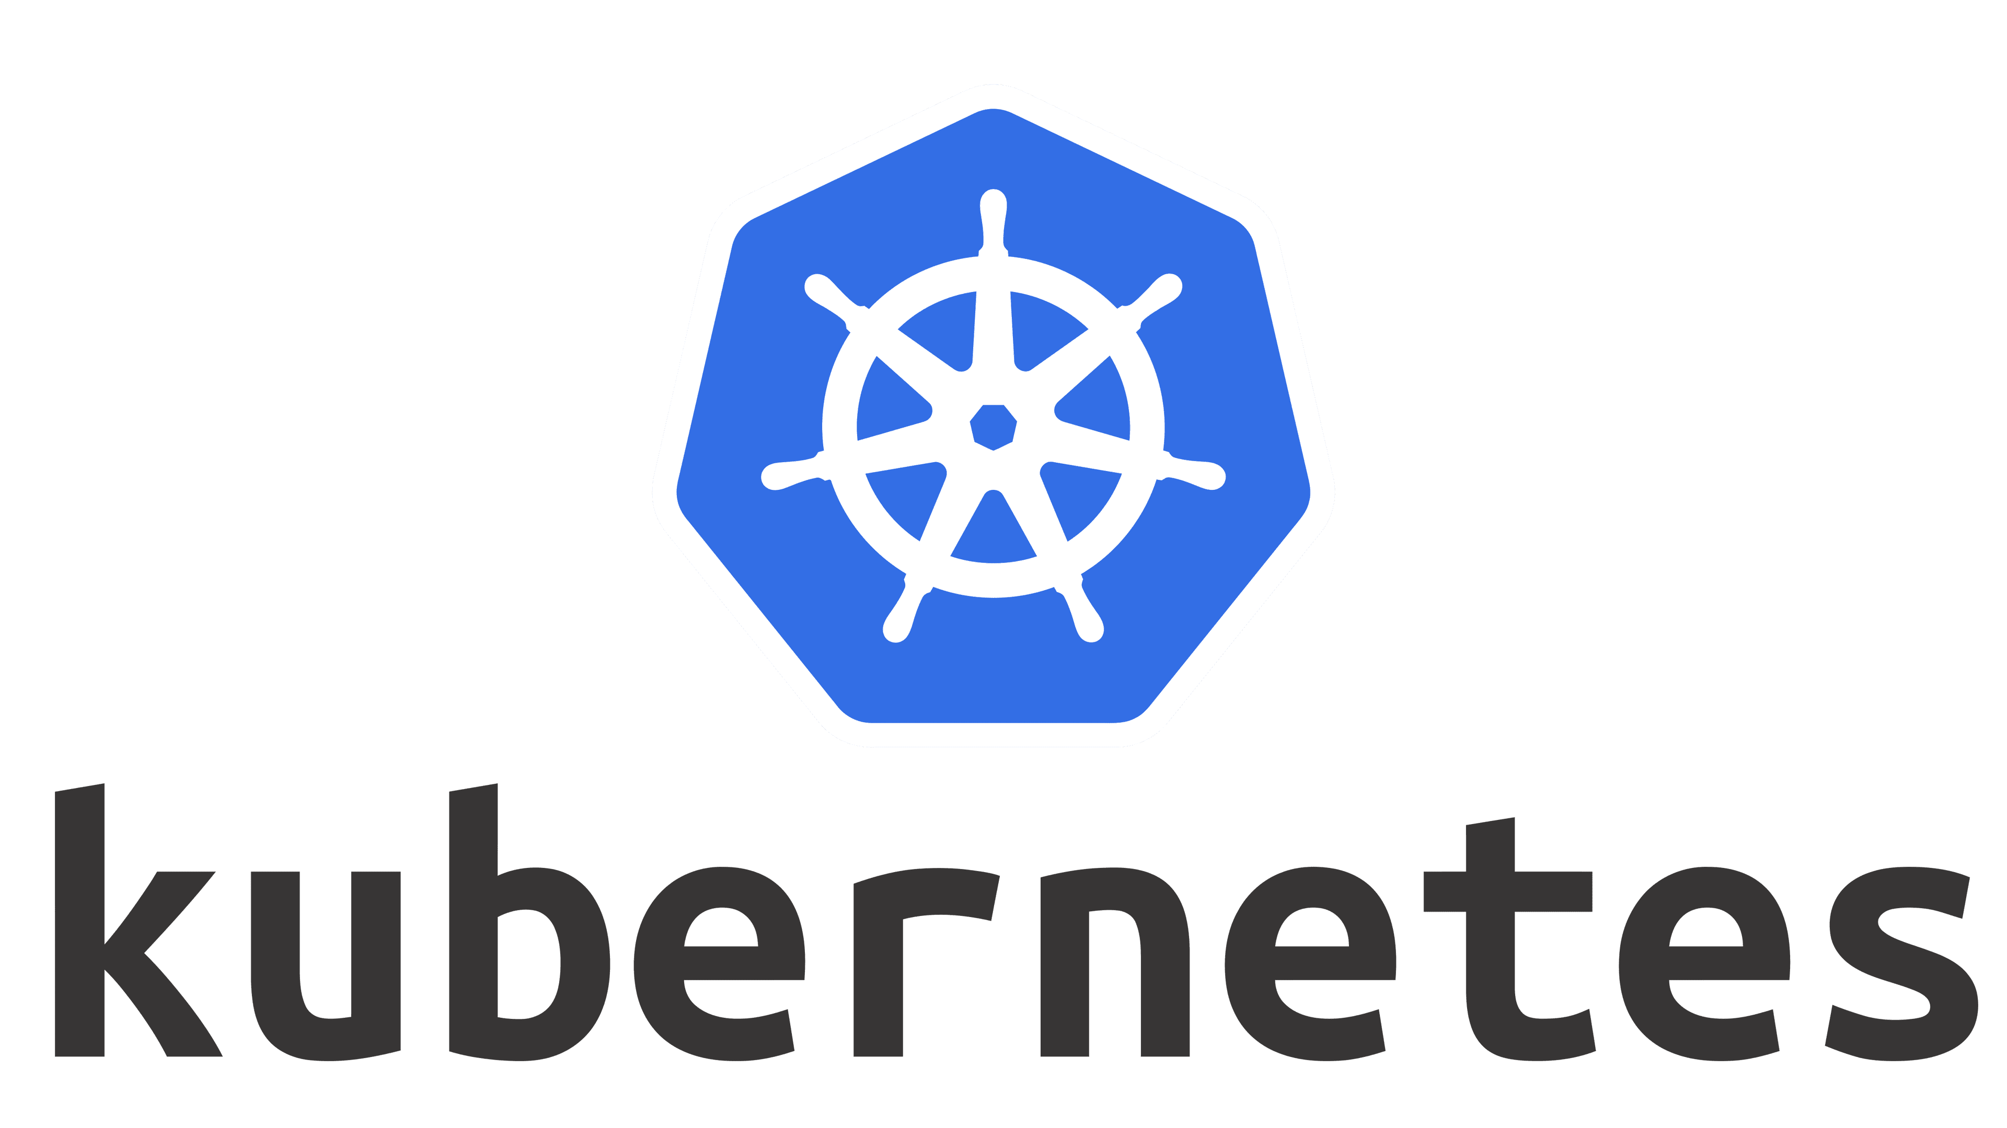




Evolving the Hybrid Cloud Platform for AI
Use cases, Applications, Infusion, Etc.
Models become part of the platform driving a need for cross-stack optimization in support of:
Model Abstraction
(train, tune, infer)
Best-in-class inference efficiency
for Granite and other watsonx models
Wide selection of tuning techniques
competitive performance
streamlined user experience for model customization
InstructLab for model alignment
Further opportunities to optimize for AI workflows
Agentic systems
AI Models, Frameworks and Runtimes
(PyTorch, vLLM, HF)
Hardware Abstraction
Burgeoning innovation in AI hardware drives increased complexity in the software ecosystem
Opportunity for the platform to provide flexibility and choice through hardware abstraction
Heterogeneous Infrastructure
…

Slide 24
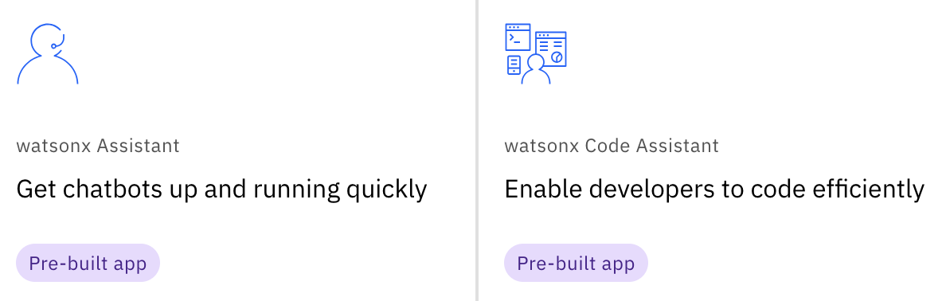
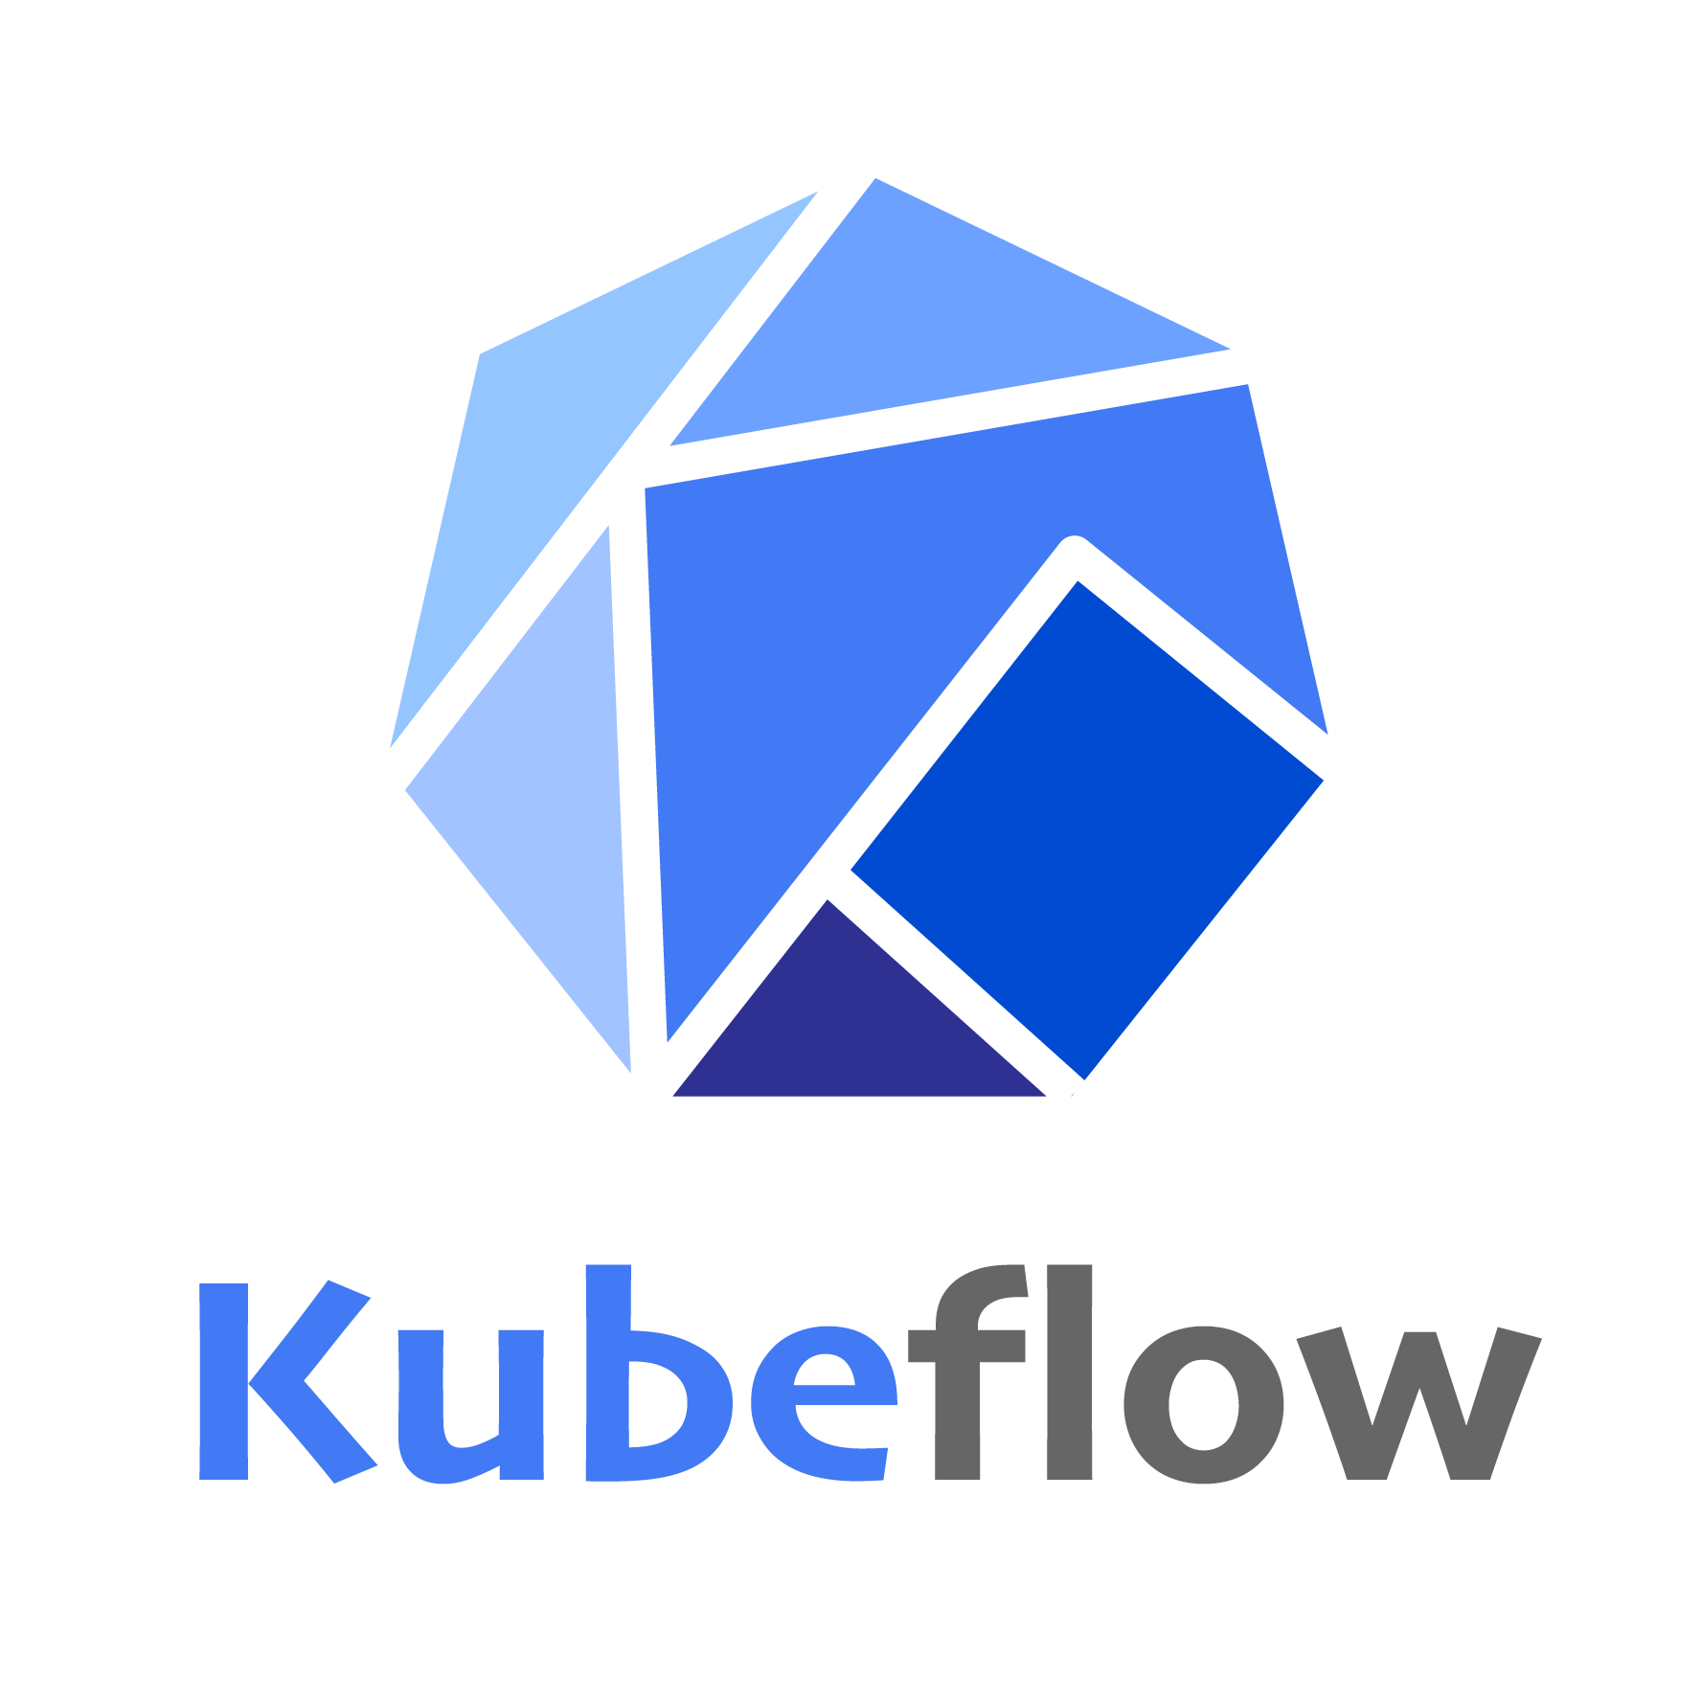
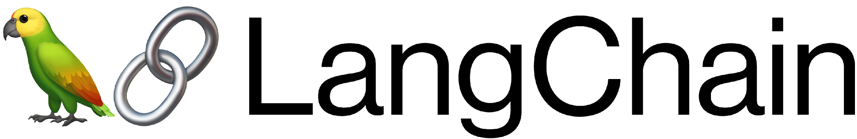

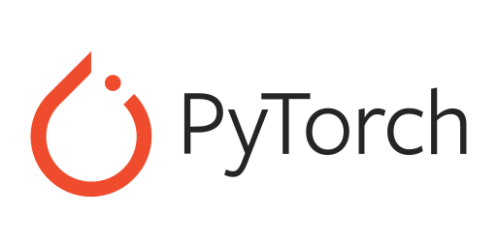

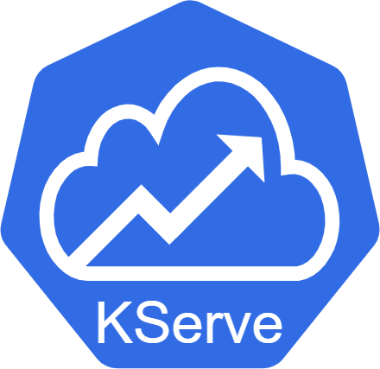
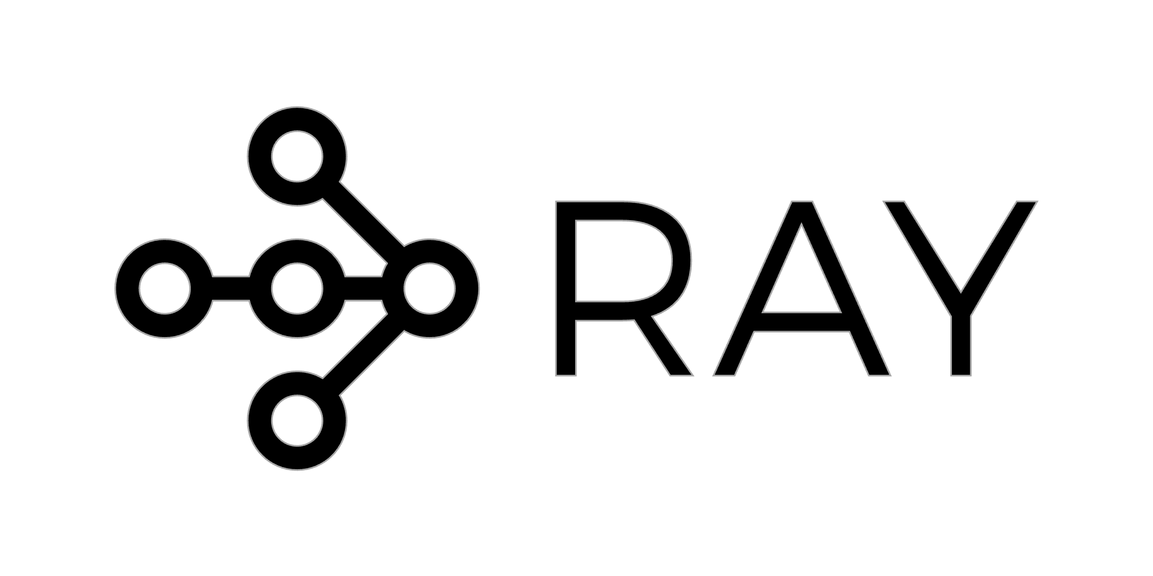


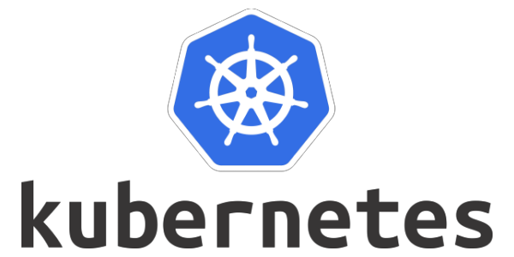
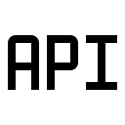

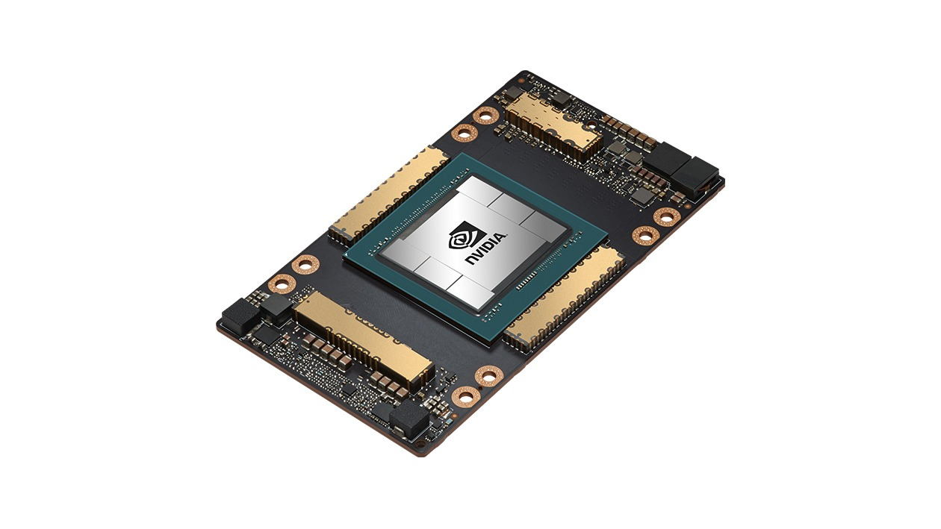
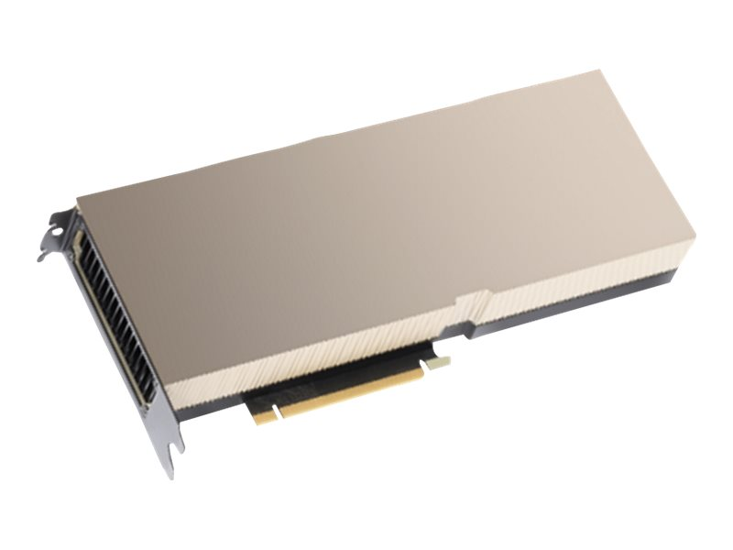
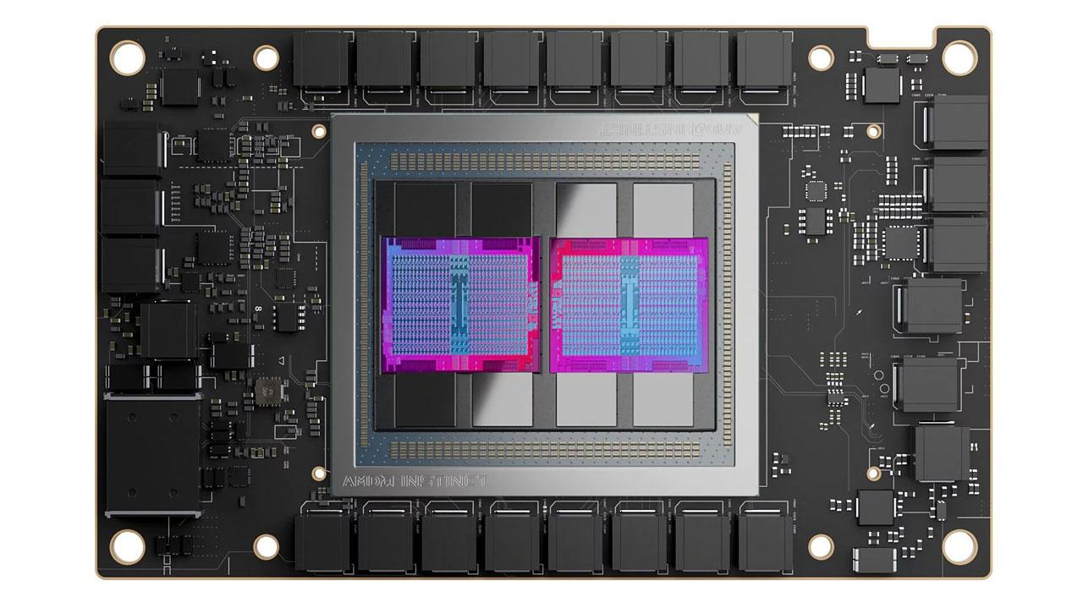
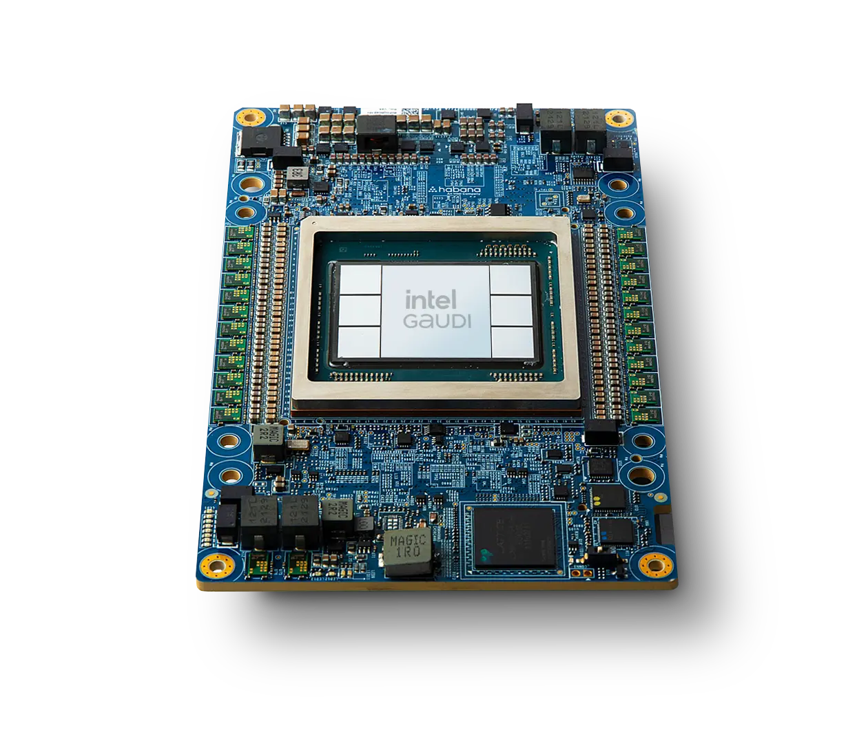
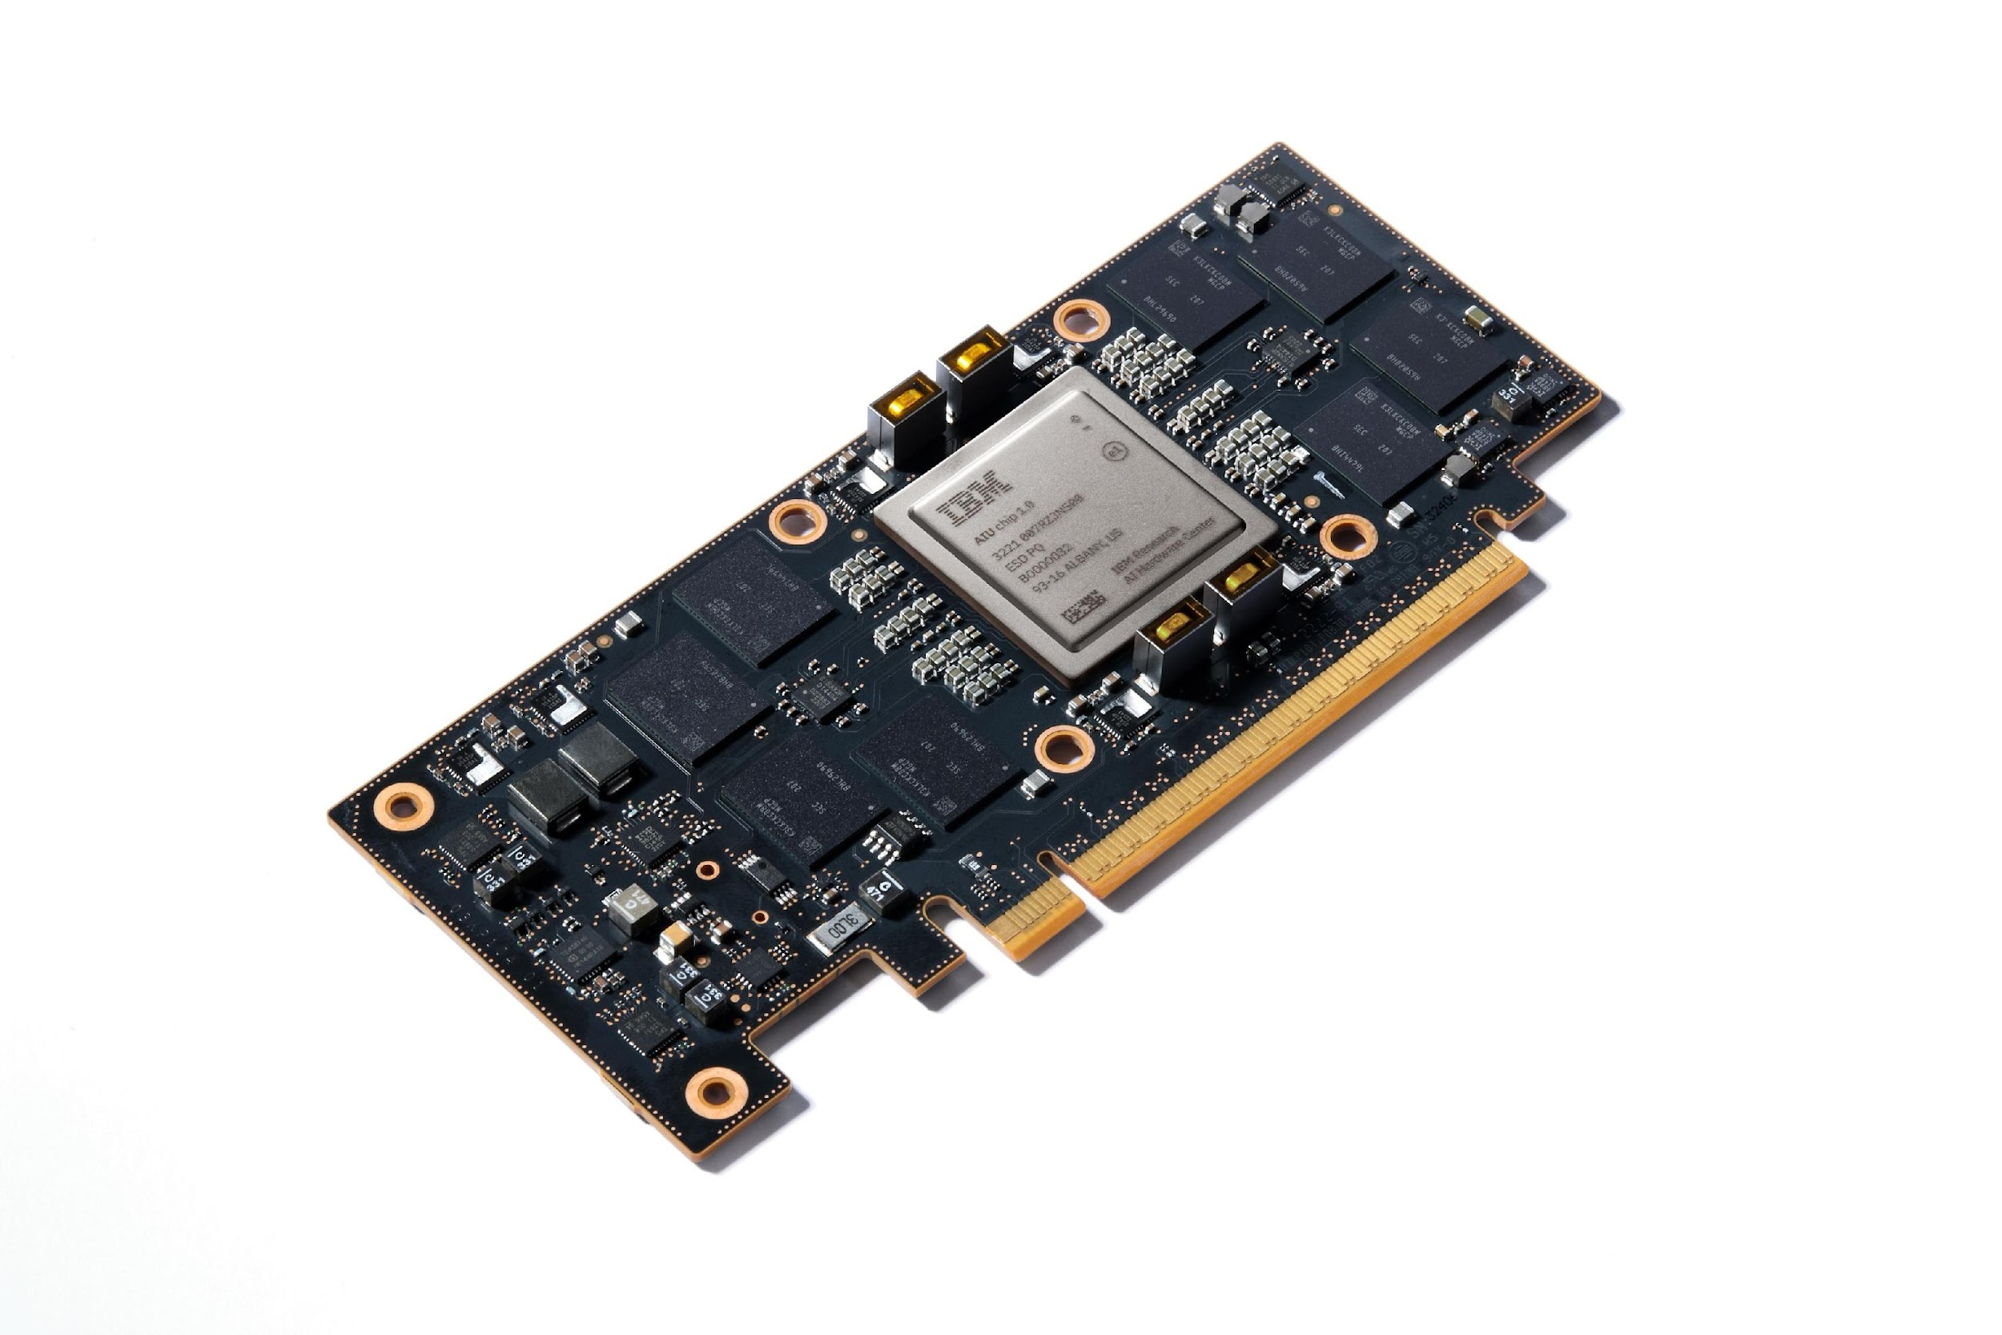


Technology Stack Based on Open Source
End-to-end AI applications
Data preparation
Distributed training
Fine tuning
Inference
Kubeflow
Pipelines
…
Distributed
HF Libraries (TRL / SFT)
Kserve
AI Platform
OpenAI Triton
KubeRay
TorchX / Kubeflow Training Operator
TGIS /
Job Scheduler (MCAD / Kueue)
InstaSlice
Dynamic Resource Allocation (DRA)
Control Plane evolution
OpenShift Virtualization
SDN evolution
Hybrid Cloud Platform / AI Cloud control plane
Hardware Programming APIs
Linux
…
OS
OS
OS
…
OS
…
Infrastructure

Slide 25
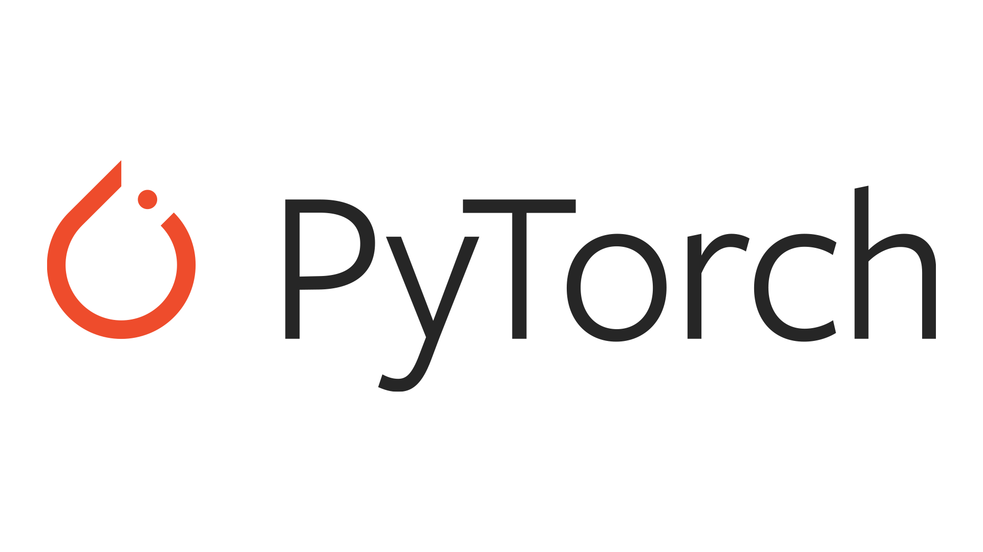

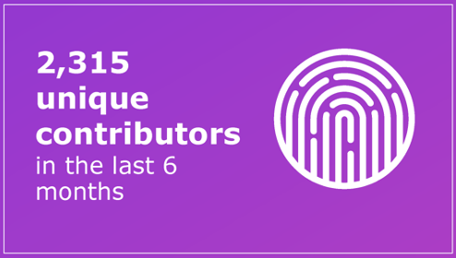
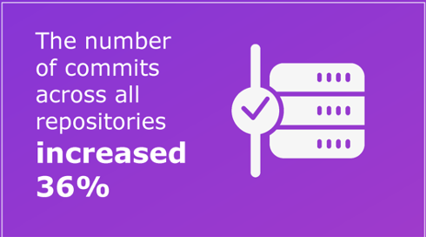
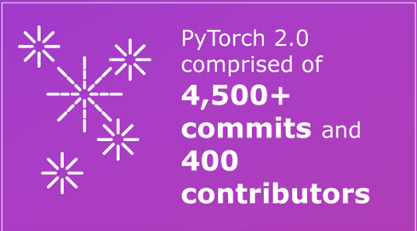
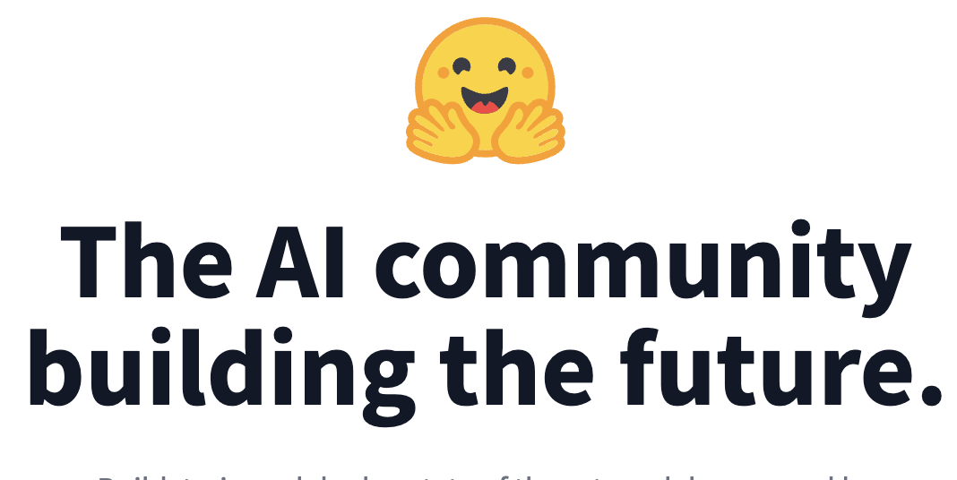
How we engage in key open-source communities
Most widely adopted machine learning framework for foundation models with over 90+% of HuggingFace models in PyTorch format.
Simplified scale out compute and automation for data preparation / validation
Largest external contributor to Ray Workflows and key APIs for making K8s best platform for Ray
Actively working on Kubernetes integration, pushing for open governance
Largest repository of models, first touch in foundation models for many clients
PyTorch Foundation governing board alongside AMD, AWS, Google, Meta, Microsoft, Nvidia
Leadership in PyTorch compile for inferencing
Key contributor to distributed training APIs and accelerated transformers
Strong partnership between IBM and HF
Seamless integration between HF & watsonx
Notes:
Level of abstraction
Pluggability of hardware
Open / not proprietary

Slide 26



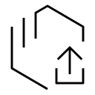




Bringing the power of community innovation to the enterprise
watsonx.ai
Enterprise-grade middleware and tools | Multi-model flexibility | Developer tools to build Assistants & Agents | Lifecycle Governance
Openshift AI
Deploy, scale, and optimize resources | Deploy models anywhere | Create model pipelines (MLOps) | Share and optimize
RHEL AI
Efficient and lightweight model runtime | Bootable model runtime | Deploy and test Granite models with support & indemnification | InstructLab for rapid experimentation customization
watsonx.ai
RHEL AI
Hybrid
Infrastructure
Physical
Virtual
Private
Public
AI Accelerator Choices

Slide 27
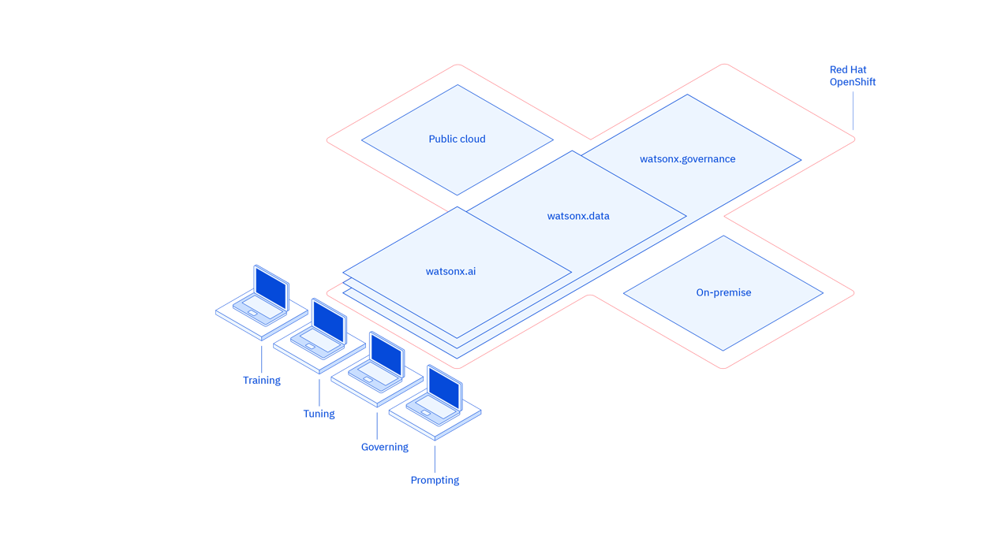
Watsonx data and AI platform
watsonx.ai An enterprise studio to build AI applications quickly and with fraction of data
watsonx.data Scale AI workloads, for all your data, anywhere
watsonx.governance Trusted – Responsible, transparent, and explainable AI workflows
Train, validate, tune, and deploy inferencing both traditional machine learning and new generative AI capabilities powered by foundation models.
Fit-for-purpose data store, built on an open lakehouse architecture to access and share data across hybrid cloud through a single point for entry.
End-to-end toolkit for AI governance across the entire model lifecycle to enable responsible, transparent, and explainable AI workflows.
© 2025 IBM Corporation
Notes:
All these concerns make IBM unique in the world of AI.
IBM has built a reputation of trust for centuries and we have prioritized the broad needs of business trying to adopt new technologies securely and responsibly.
Gen AI is no exception.
IBM has built Gen AI with watsonx with businesses in mind that want to build their own AI solutions or use models and data that is secure, open, flexible, and scales easily.
Watsonx.governance allows for implementing responsible, transparent and explainable AI through toolkits supporting the entire model development, deployment, and tuning lifecycle.
IBM is also unique when it comes to infrastructure. Our focus on multicloud, hyprid-cloud and highly regulated industries like financial services, provide a much greater focus on the data and model governance needed to build responsible Gen AI solutions.

Slide 28
Thank you!

